Slide 1
US Heart Disease Analysis for 2014
Mary Alice Salazar
Kaushik Sanaddar
Prasanna Jaiswal
DG OMG BRO

Slide 2
Motivation & Summary
We looked at heart disease because it is the number one cause of death in the United States.
According to the CDC:
About 610,000 people die of heart disease in the United States every year–that’s 1 in every 4 deaths
Heart disease is the leading cause of death for both men and women. More than half of the deaths due to heart disease in 2009 were in men
https://www.cdc.gov/heartdisease/facts.htm
We found that there is a high number of occurrence of heart disease in every state. We drilled down on gender, poverty, obesity and risk factors such as smoking, alcohol consumption, high school obesity, and adult obesity. We also found a strong correlation between the risk factors and data values.

Slide 3
Data Sources and Questions
Data sources:
Data.gov: Heart_Disease_Mortality_Data 2014
CDC: Heart Disease Death Rates (2014)
US census 2014
Questions :
What is the rate of heart disease among the US population?
Is there a difference in occurrence for gender, poverty, and other groups?
What are possible causes? i.e. smoking, alcohol, adult obesity, high school obesity?
These data sources contained data for each of these questions.
From the first, we gained information about gender
From the second data source, we gained data for mortality and risk factors.
From the census, we found poverty data.

Slide 4
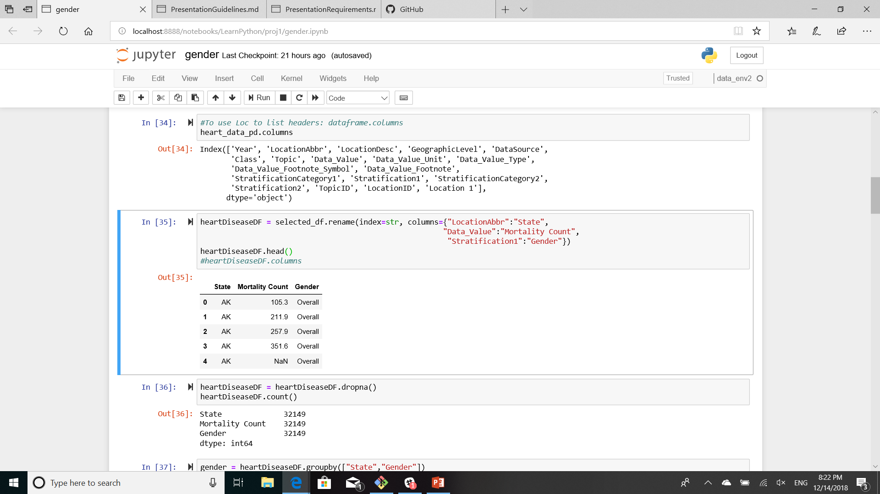
Data cleanup and exploration
We did minor cleanup on the data. There were some renamed columns, and we sliced the csv columns. For example, different data sources had different nomenclature for the states. We picked good sources.

Slide 5
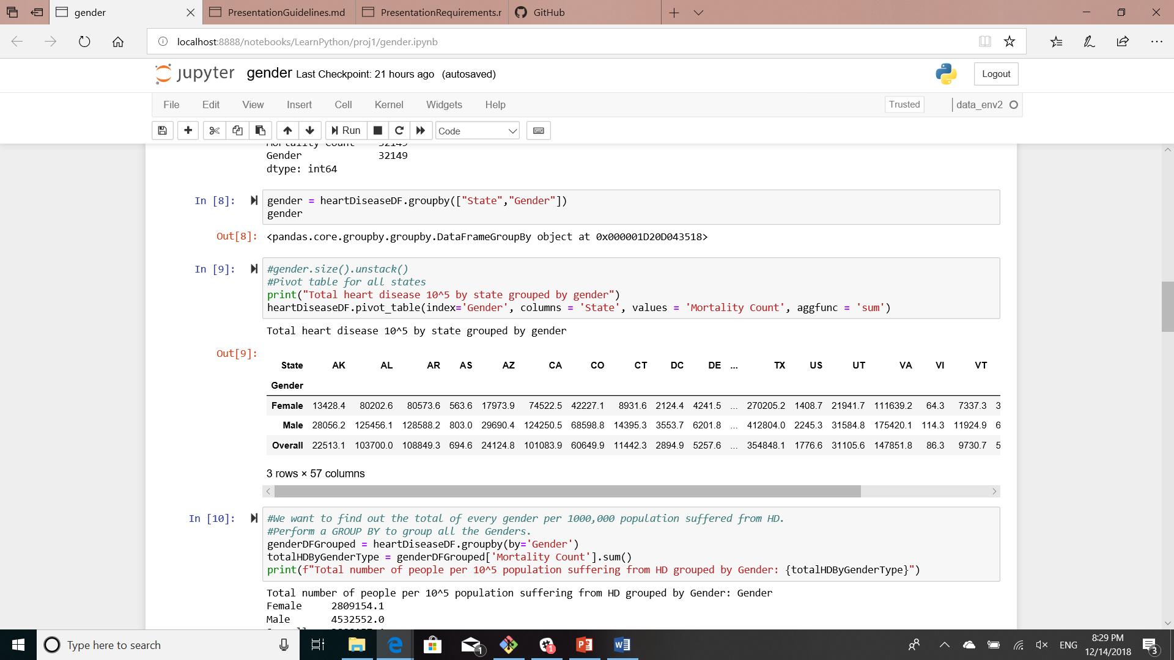
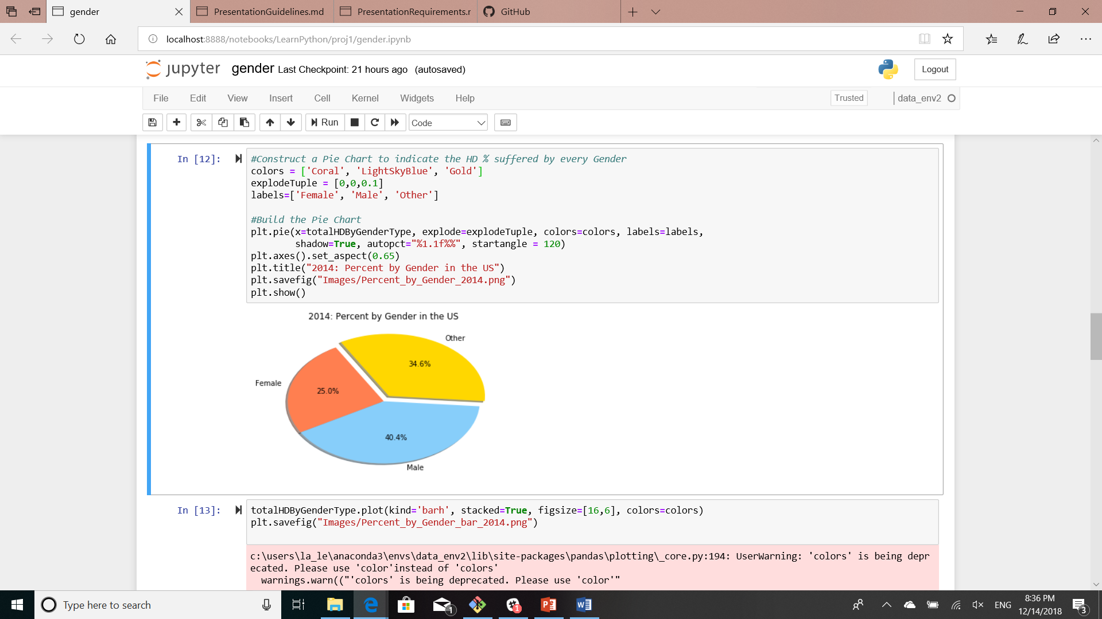
Pivot table and pie: gender

Slide 6
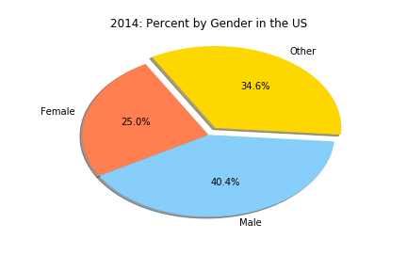
Males had a higher occurrence of heart disease in US

Slide 7

Analyzing Diabetic Cause Relation

Slide 8
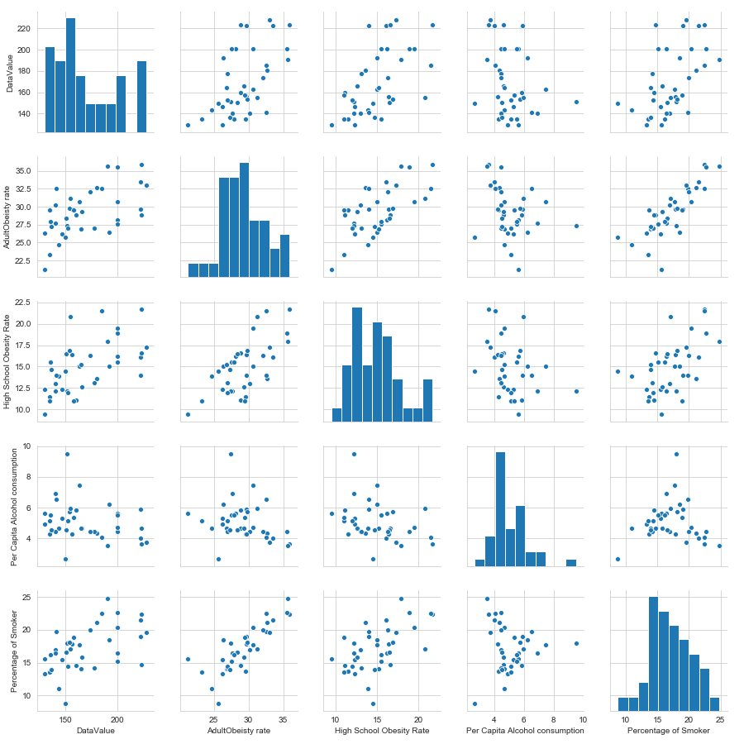
Checking for Normalization and Linearity

Slide 9
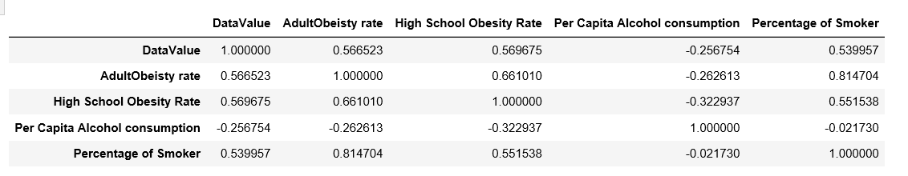
Correlation Coefficient Value (R Value)
#Calculate Pearson correlation Coefficent
corr = test_new.corr()
corr.to_csv('Correlation Values.csv')
corr

Slide 10
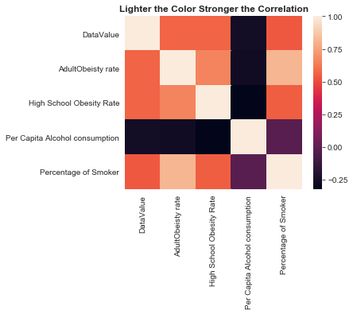
Correlation Coefficient

